Slide 1
Cork | Sec #10
18:30-19:15 Socialising (Nothing starts on time ☺)
19:15-19:45 Ras PI Home Security – Jim Curtin
20:00-20:45 – Building your own PWNPAD - Bob McArdle
20:45-??? More Socialising
SSID: FreeWifiAskServerVIP = sohowifi
Meetup.com/CorkSec

Slide 2
Building your own PWNPad (and what you can do with it)
Bob McArdle
@BobMcArdle
Cork | Sec

Slide 3
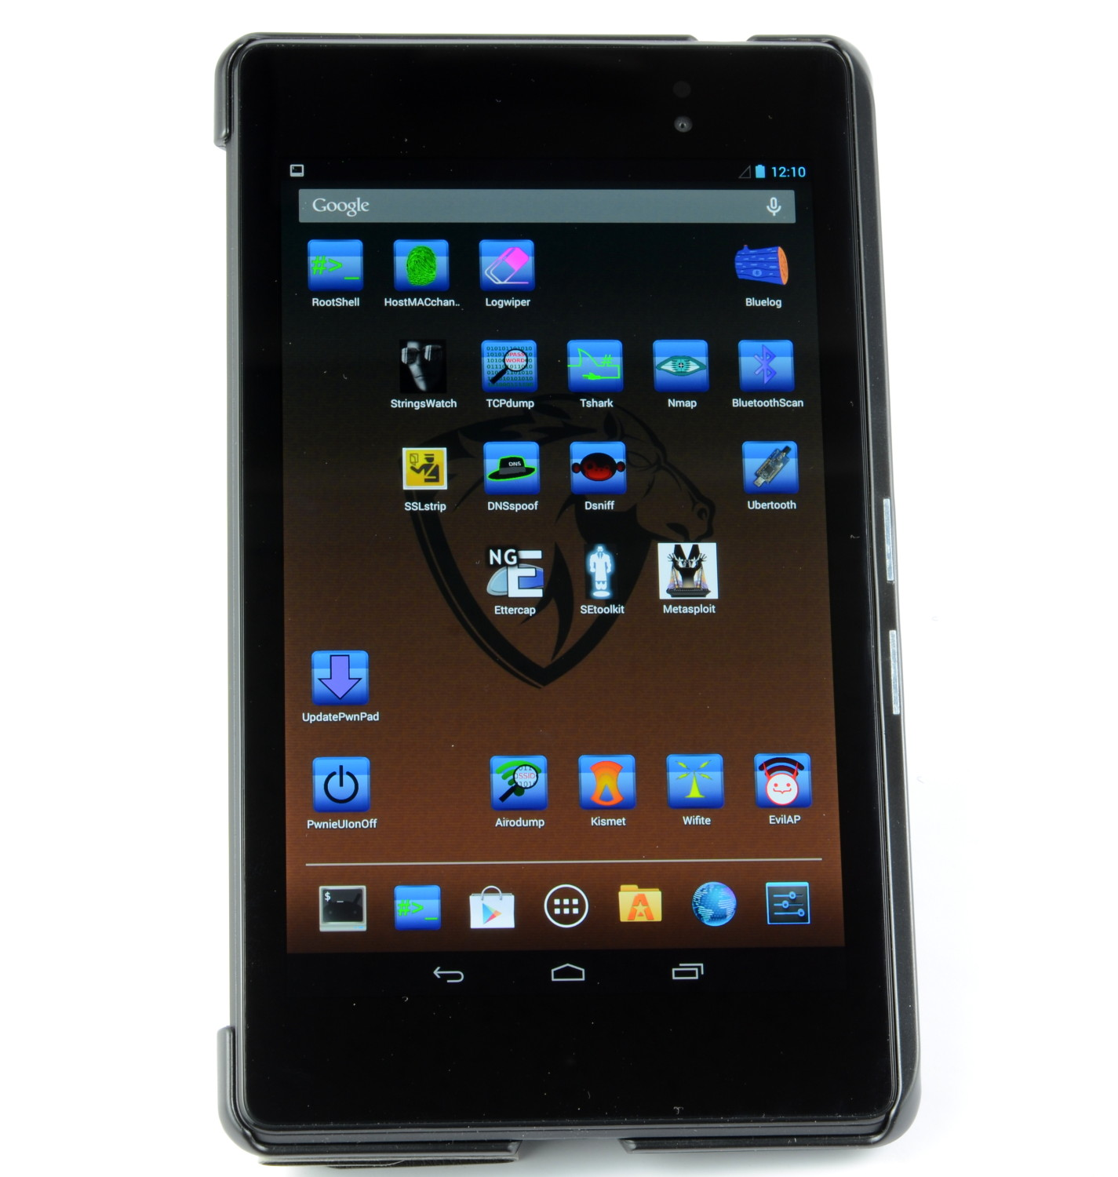
Notes:
So first things first – what is a PWNPAD (SHOW)
Looks like a Nexus 7 – right?
Correct – It is , but it has been modified to have bunch of hacktools on it – essentially think of it as a stripped down, very portable, version of Kali
The problem with a PWNPad is that it has one rather big drawback…

Slide 4

Notes:
And that’s the price tag. I don’t know about you but 1K definitely takes things outside “impulse buy territory”
There are a lot of other things you could spend 1000 dollars on for example 150 beers here in SOHO, or around 2000 beers in the Philipines
But of course there is a better option – build it yourself!

Slide 5
€300
Notes:
For a little over 300 euro you can build your own PWNPAD, and of course even less if you already own a Nexus 7. That a lot better sounding
But why would you want a PWNPad in the first place – especially if you already have a VM image or laptop running Kali Linux (which has much more software on it)?
The main reason is that it is much more portable – so its great for things such as Wifi Pen-Testing.
And being more portable also means you can always have it with you – for example at a bar you would be unlikely to have your laptop with you, but if you whip out your PWNPAD you can use it to impress girls with your skills.

Slide 6

Notes:
As we all know Chicks dig leet skillz!
Everyone here has seen Hackers the movie? Zero Cools skills mean he ends up with Angelina Jolie at the end of the movie.
And for the girls in the room don’t worry, Angelina Jolie eventually ends up with Brad Pitt – so it ends well for everyone.
The moral of this kinda round about story is that have cool portable hacking devices has lots of good uses!

Slide 7
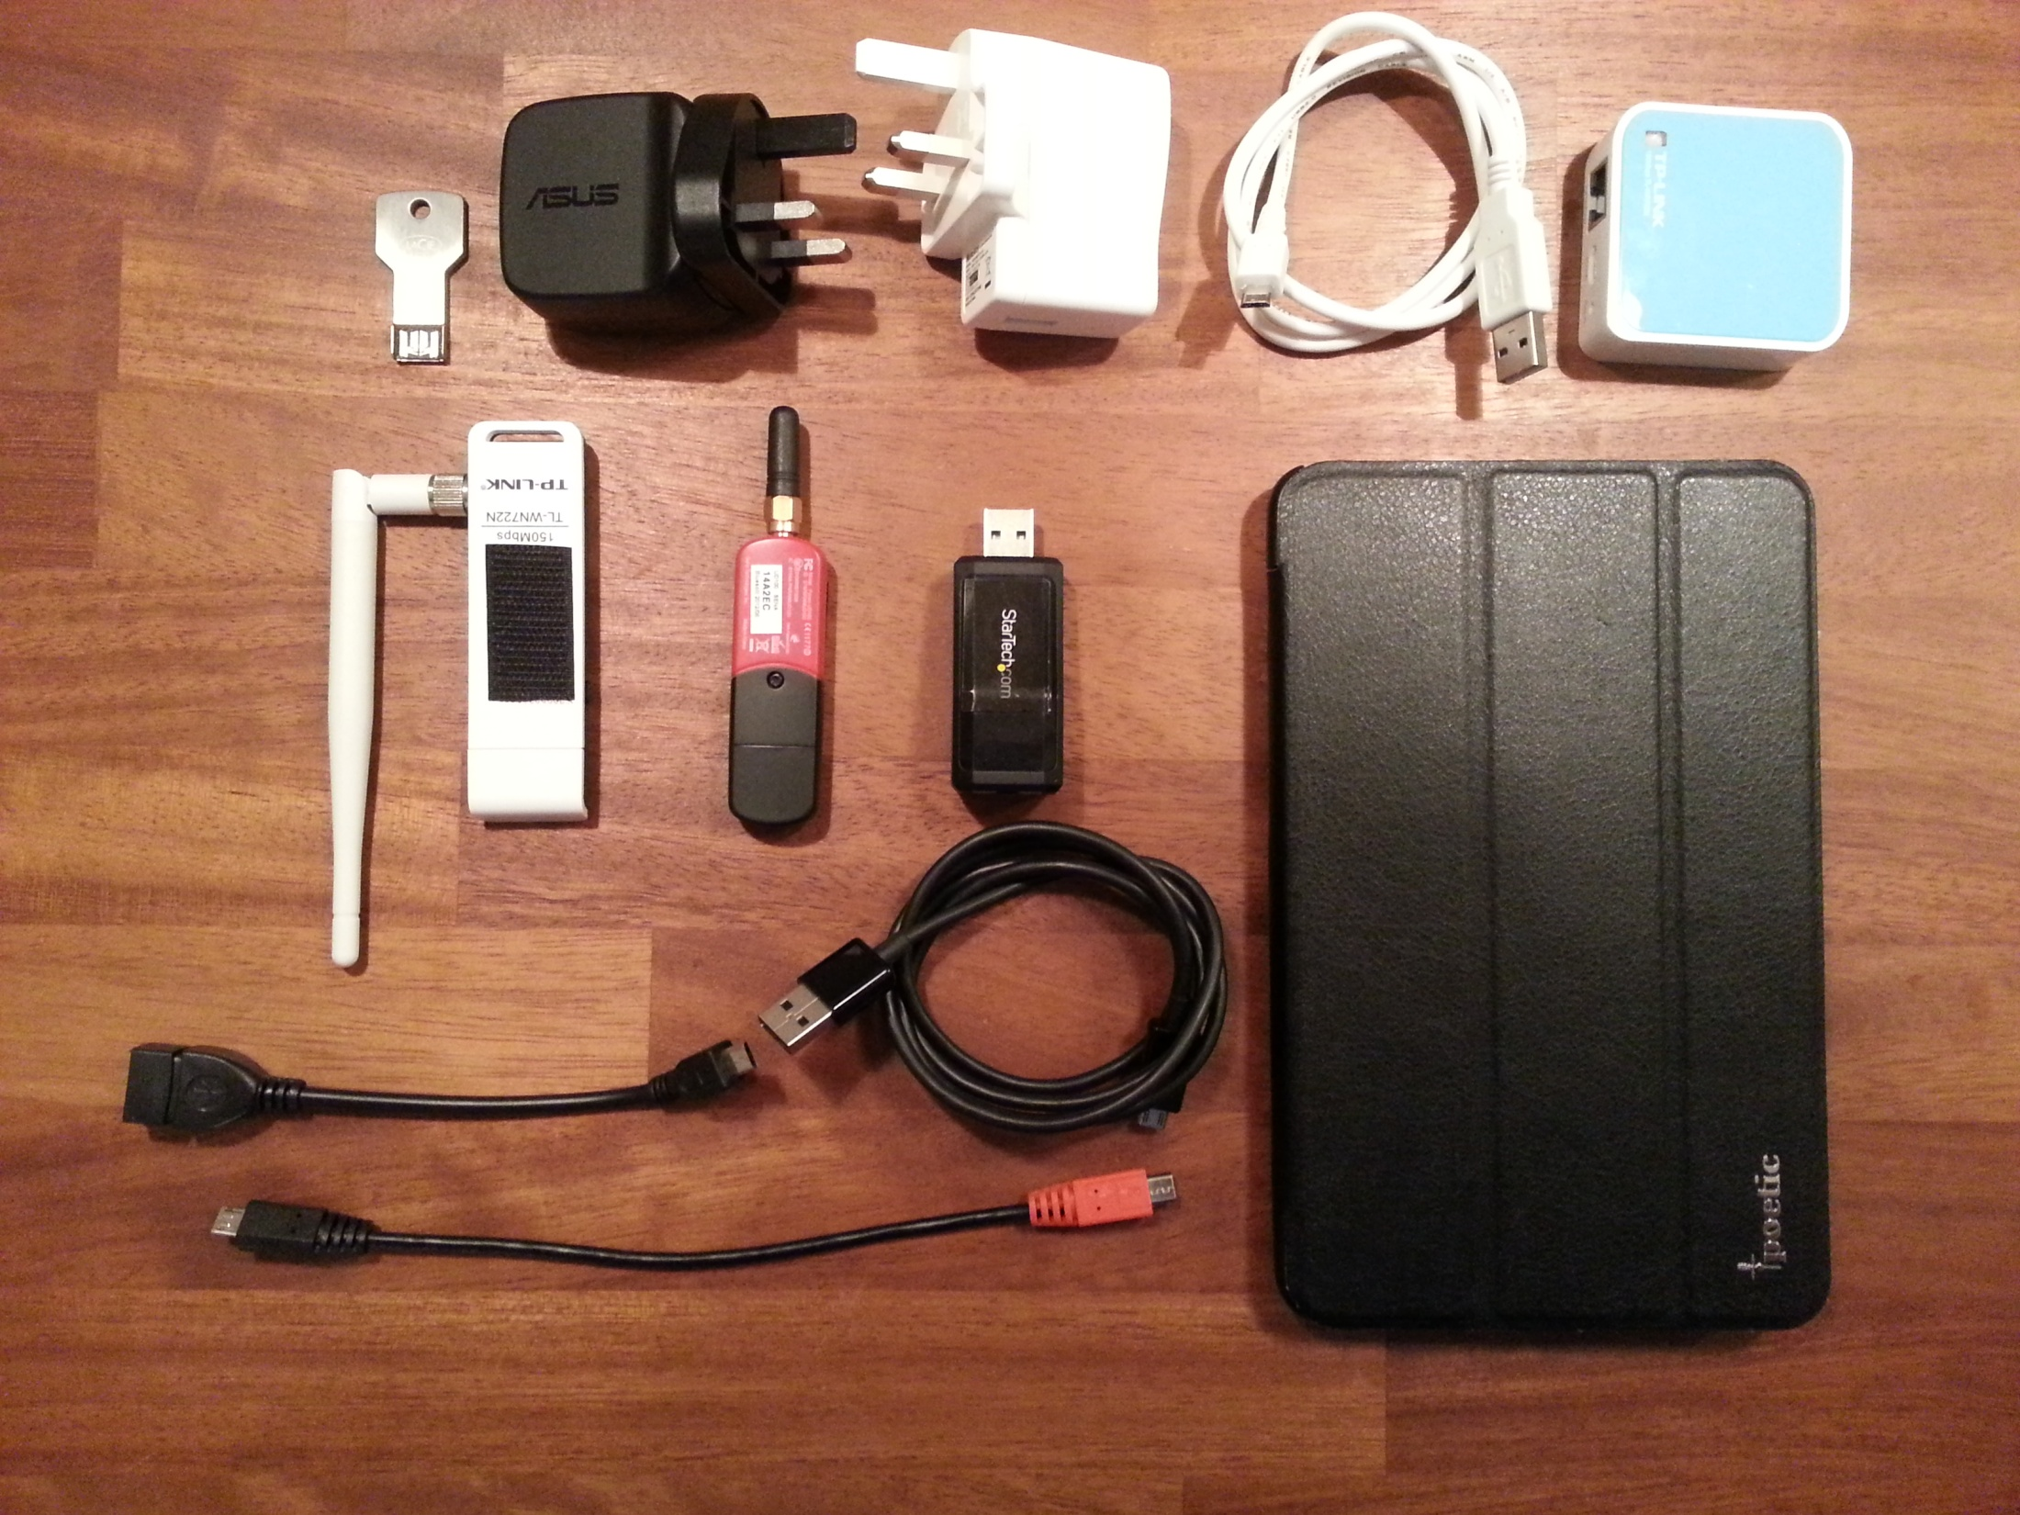
Notes:
Joking aside – what do you need to assemble a PWNPAD. For the full experience you will want everything on this slide – but realistically you need a lot less than that.
On the slide you can see some plugs up the top, as well as a portable TP-Link WIFI AP. Down the bottom are some cable , and we have some adaptors in the middle. But of all those the only ones you actually really need are the following:
Next lets take a look at the various Adapters and Cables. You should have:
Nexus
The Nexus itself of course – either the 2012 or 2013 versions will be fine. Obviously the 2013 version is a bit better – its has better resolution and CPU, but actually less battery live. You should get the 32GB version and also I’d recommend getting the version that supports a 4G/3G card – that would let you SSH to the device over the mobile network which is really useful for leaving the tablet behind on attacks.
TP-Link TL-WN722N USB adapter
Has Tplink 80211n Atheros Chipset. This wifi card supports injecting packets, promiscous mode and monitor mode – which we want for our testing. You can also add other antenna – e.g. a directional antenna or higher gain antenna. The standard antenna is 4dBi
Cables
Namely a OTG Cable. Allows you to connect USB Keys and appliances to the device
Apart from that the other adaptors here are a SENA UD100 for Bluetooth (not that useful), an Ethernet adaptor and of course power cables and there is a Protective case with velcro to attach the antenna
One gotcha about using the cables and adapters - you can not charge the device at the same time. If you want to, there are some patches for the PWNPAD available online that will allow you to charge and use an adapter at the same time - and you'll need a splitter cable - but I did not install them in order to keep it as stable as possible.

Slide 8
Nexus - €289
TP-Link - €11
OTG Cable - €5
Case - €12
TOTAL - €317
Notes:
Totaling that all up we get
And if you shop around on eBay you should be able to get a 2nd hand Nexus for even less than that, or better yet if buying in the US you will get it much cheaper due to the exchange rate
So for the rest of this talk we’ll talk about how to setup (not every step as I will add links to the PDF later), and then I’ll give a quick overview of how you can make use of it. I won’t cover Wifi hacking in great detail, even though it is excellent for that, as we already had a CorkSec on Wifi Hacking.

Slide 9
$ sudo add-apt-repository ppa:nilarimogard/webupd8
$ sudo apt-get update
$ sudo apt-get install android-tools-adb android-tools-fastboot
Notes:
So to start off you need a Debian based OS – they recommend Ubuntu 12.04 or better, ideally not in a VM. Personally I downloaded a live USB version of Ubuntu.
Apart from that at this stage you also need the Nexus itself, the USB cable that came with it and the firmware and scripts for the community edition from PwnieExpress.
Incidentally the differnence between the commercial version and the community version is mostly updates and support – but I’ll show you how to get the updates later on.
The process used to be a lot more convoluted in the past – involving swapping over USB Keys and various things, but they have streamlined it a lot.
STEP 1:
So the very first thing you want to do is to install ADB + Fastboot tools – these will allow you to communicate with the Android device in debug mode.
3 simple commands should get this sorted for you.

Slide 10
$ tar xvf pwnpad-*.tar.xz
$ cd pwnie_img/
$ chmod +x imagev2.sh
Notes:
STEP 2:
Next you want to untar the latest pwnpad image, then change into the pwnie folder and made the imagev2.sh script executable.
At this stage simple attach the PWNPAD to the Ubuntu machine using the stock USB cable that comes with the Nexus.
Before you go any far (actually even before this step – remember to backup anything you have on the device – its going to end up being COMPLETELY wiped.

Slide 11
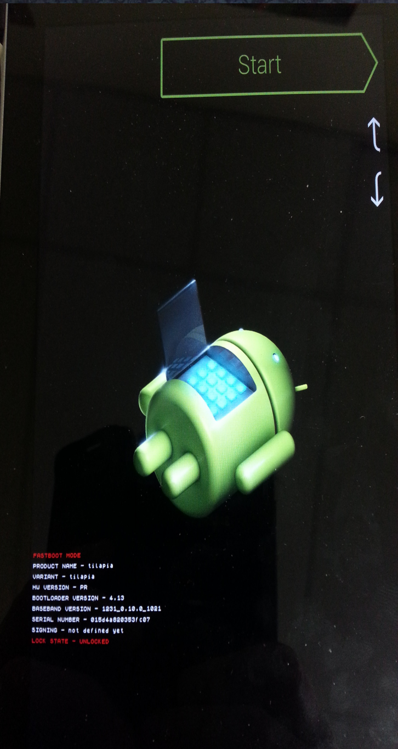
Notes:
STEP 3:
Now you want to Fastboot the Nexus. In other words, turn it off. Then when turning it on Power it on with the Volume Down button held down – this gets you into the menu you can see here really quickly – which lets you reflash the device.

Slide 12
$ sudo adb start-server
$ sudo ./imagev2.sh
Notes:
STEP 4:
At this stage there are just two things more to go – starting up the Android debug server and then running the imagev2.sh install script.
And from here on just follow the steps – its really self explanatory.

Slide 13
wget -O - http://pub.pwnieexpress.com/updates/pwn_pad/latest.sh | /bin/bash
Notes:
STEP 5:
One final thing that is worth doing – that you won’t find in the official documentation. Once you have the PWNPad up and running open a Rootshell and execute the following line
This will actually pull down any updates from the commercial server so now you are as up to date as you can be.

Slide 14
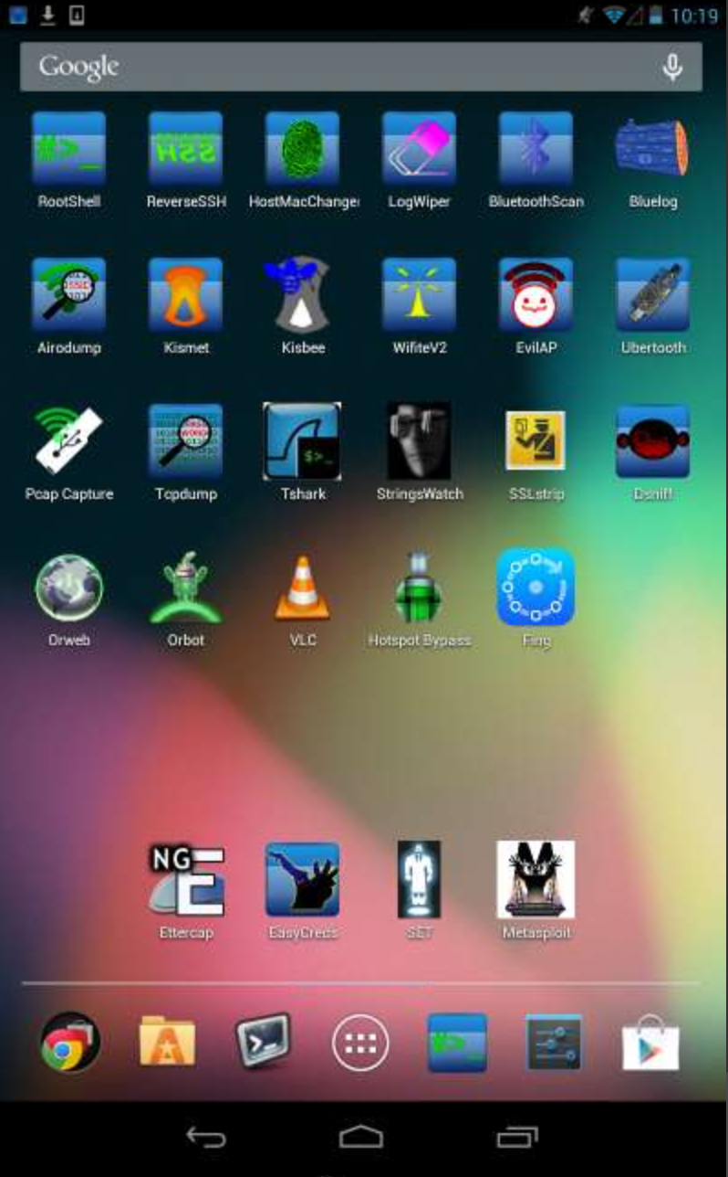
Notes:
DEMO
Once you’ve done all that you are good to go – and this is what you will see. Actually this is slightly out of date, as I have not flashed the latest and greatest firmware on here yet – but all the tools are the same. I’ve also add a few extra tools on top which I will get to in a minute.
What you are looking at at is an Android environment that is also running Linux underneath. The Linux OS is essentially running in a chroot environment, so you can run both Android and Linux apps independantly of each other.
Before going onto demoing some of the features – there are a few minor tweaks I would personally recommend to do. I also won’t go over all elements of the UI as it should be very straightforward for anyone familiar with Android, and its well documented in the manual.

Slide 15
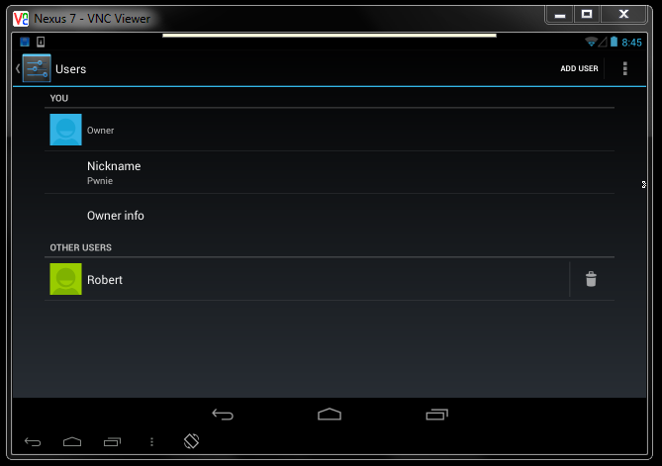
Notes:
Firstly you’ll want to register your Nexus with a Google account – I’d recommend to set up a dedicated one for the PWNPAD image part.
Once you register the account you will be asked if you want to backup automatically – choose not too. It will cut down on unwanted traffic in PCAPs etc. Go to account in settings on the Pad and turn off all sync settings too.
But you'll of course be tempted to use this like any other tablet - download your mails, check your social networks, watch movies and play Angry Birds.
There is absolutely no reason you can't do this - but one thing I would recommend is to create a second user especially for this
Simply go to Settings->Apps->Users->Add User
In general its a good idea to not have any push notification apps on the 2nd user. Also if you are using the 2nd user, and then swap over to the PWNIE account – the other users apps will still be running in the background, and there no easy way to kill them. I simply restart the pad to ensure the second user is not running when doing a test / demo
One last thing to point out at this stage is that you should not install updates to the Android OS itself, and they will almost definitely mess up the PWNPad setup

Slide 16
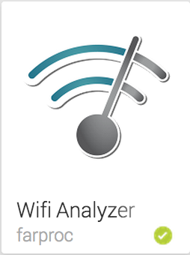
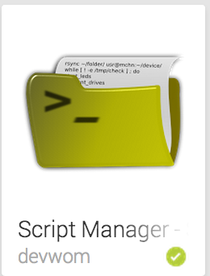
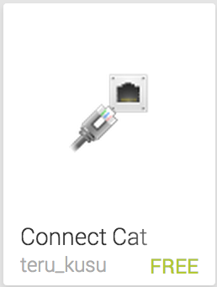
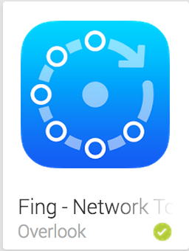






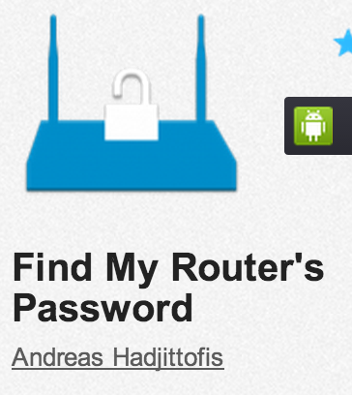
Notes:
Nowadays Android actually has some really good apps for network pen-testing and other utilities – and some of these do not come with the PWNPad itself of copyright reasons. One the slide is a list of the ones I would personally recommend to install.
Wifi Analyser – Handy little Wifi visualising tool
S Manager - very handy file manager (and can access the Ubuntu part, unlike the popular Astro)
USB OTG Helper – For support on attaching USB keys
Connect Cat – Kind of like netcat for Android
Fing / WifiInspect – Mapping your network
Hotspot Bypass – Simple app that hijacks an authenticated session for paywall wifi networks
OrWeb – TOR Browser
VMLite VNC Server – what I am using here
Find My Routers Password – this is on Appzoom not Google Play. Has default passwords for most routers, or can do dictionary attacks / brute force.
Note for S Manager the Ubuntu part is in /data/local/ubuntu/opt/
Also download a password cracking list from http://xato.net/passwords/more-top-worst-passwords/ or anywhere else
Of course you may want to download and install your favourite command-line linux tools as well . The PWNPad features a lot more apps than the handful of icons you can see on the screen, and you can easily install all of your normal tools as well – for example I personally am a big fan of the Recon-ng framework and OSINT tools like theharvester.py

Slide 17
[)3M0
Notes:
So that’s enough slides – lets finish out this talk by showing some cool demos of what the tools can do. Really the possibilties are almost endless as I said, and especially on the Wifi hacking side the PWNPAD really comes into its own. But for this demo I’m going to just show some different things
DEMO 1 – Evil AP + Login theft with DSNIFF
EvilAP
Connect Phone
Strings watch – definitely have something
Robertmcardle.com/demo/ - corksec / demodemo with dsniff
DEMO 2 - SET
SET – 1 – 2 (Website) – 3 (Credential Harvester) – boards.ie (try from the Mac) – Or does someone have a favourite
Just need to get the person to click on that page – can do in lots of ways. Hijack the DNS – MITM etc.
Clean up all processes
DEMO 3 – Unreal IRC vs Metasploitable

Slide 18

Notes:
Useful Links
Buy PWNPAD - https://www.pwnieexpress.com/penetration-testing-vulnerability-assessment-products/sensors/pwn-pad-2014/
PWNPAD Manual - http://www.pwnieexpress.com/wp-content/uploads/2013/11/PwnieExpressUserManual-PwnPad.pdf
DIY PWNPAD Guides:
Latest - http://www.pwnieexpress.com/wp-content/uploads/2013/12/PwnPadCommunityEdition-FactoryImageInstallationGuide.pdf
Older - http://cdn.shopify.com/s/files/1/0233/9809/files/Build_Your_Own_PwnPad_-_DerbyCon_2013.pdf

